Slide 1
attacks
C
Y
B
E
R

Slide 2
What is cyber attack ?
A cyber attack is an assault launched by cybercriminals using one or more computers against a single or multiple computers or networks. A cyber attack can maliciously disable computers, steal data, or use a breached computer as a launch point for other attacks. Cybercriminals use a variety of methods to launch a cyber attack, including malware, phishing, ransomware, denial of service, among other methods.

Slide 3
What cyber attacks can do ?
electrical blackouts
failure of military equipment
Theft of money
Causes loss of the electrical power network supply to an end user.
It can disable and destroy electronic and wireless connections between military equipment's.
Causes sometimes to steal money from banks or from banks customers.
Data breaches
Harms electronics devices
Expose your privacy
Causes data to be sold or stolen or published to the rest of the internet.
It can destroy or harm electronics devices or can cause failure to turn on devices using viruses and malwares.
It can expose your private information to unauthorized people by hacking your network and your devices.

Slide 4
How to Avoid cyber attacks ?
Always stay up-to date
Keep your application and software always up-to date to the latest versions.
Don’t trust suspicious websites
Avoid entering any website that’s looks suspicious and only use websites with ( HTTPS ) protocol.
Don’t share your private info to anyone
Try not to give your private information to anyone until you are 100% trust the person you want to give your information to.
Use a strong anti-virus programs
The strongest step to avoid cyber attacks is to use a strong and reliable anti-viruses like ( Kaspersky ).

Slide 5
How to bypass windows security ?
To let our Virus, bypass windows defender, we should encrypt it with a strong algorithm like
( RSA ), an example a tool that can encrypt is ( SPIDER HACK TOOLS ), after that we will check if windows defender will detect the virus or not before sending, we will use
( VIRUS TOTAL ), if the result is “Clean”, windows defender will not detect the virus.
Example of how we can send the virus :
1- Email.
2- Untrusted websites.
3- Social media.
4- Open ports.
5- Media like pictures-videos.
6-hard drive
And if we want to make a backdoor for a device in the same network, that will be easy because we have a mutual open port, so this is a good point to exploit it …

Slide 6
A Cyber Attack
C
R
E
A
T
E

Slide 7

Our attack explain
Cyber-Eto Team

Slide 8

In this Section : in the same file of ransomware, we write a terminal commander code (tool) that helps you to decode your files and this tool has 3 options:
1-pay for key!
This option will redirect you to a phishing website and this website is hosted, you can Pay using a Debit card or PayPal after Payment automatically will download the key in the TXT file
2- know more about JD
In this option, you will redirect to a website to know how much is a Jordan Dinar in dollars so you can transfer … we are here to help ; )
3. Decoder files
If you paid the money to succeed SO you have a Password or key,
In this option, the terminal will ask you to give him the Key if it corrects so all your files will return to their original mode (Decrypted).

Slide 9
Command Section ; )

Slide 10

First Step .We make Ransomware with the terminal commander tool using python used Library: .cryptography – os - system,name – fernet –webbrowser - time - tkinter After that, we call a method and use the Fernet Algorithm to Encode all files in the same directory (prefer system files) and another method to Decode all encrypted files while The victim has The key

Slide 11
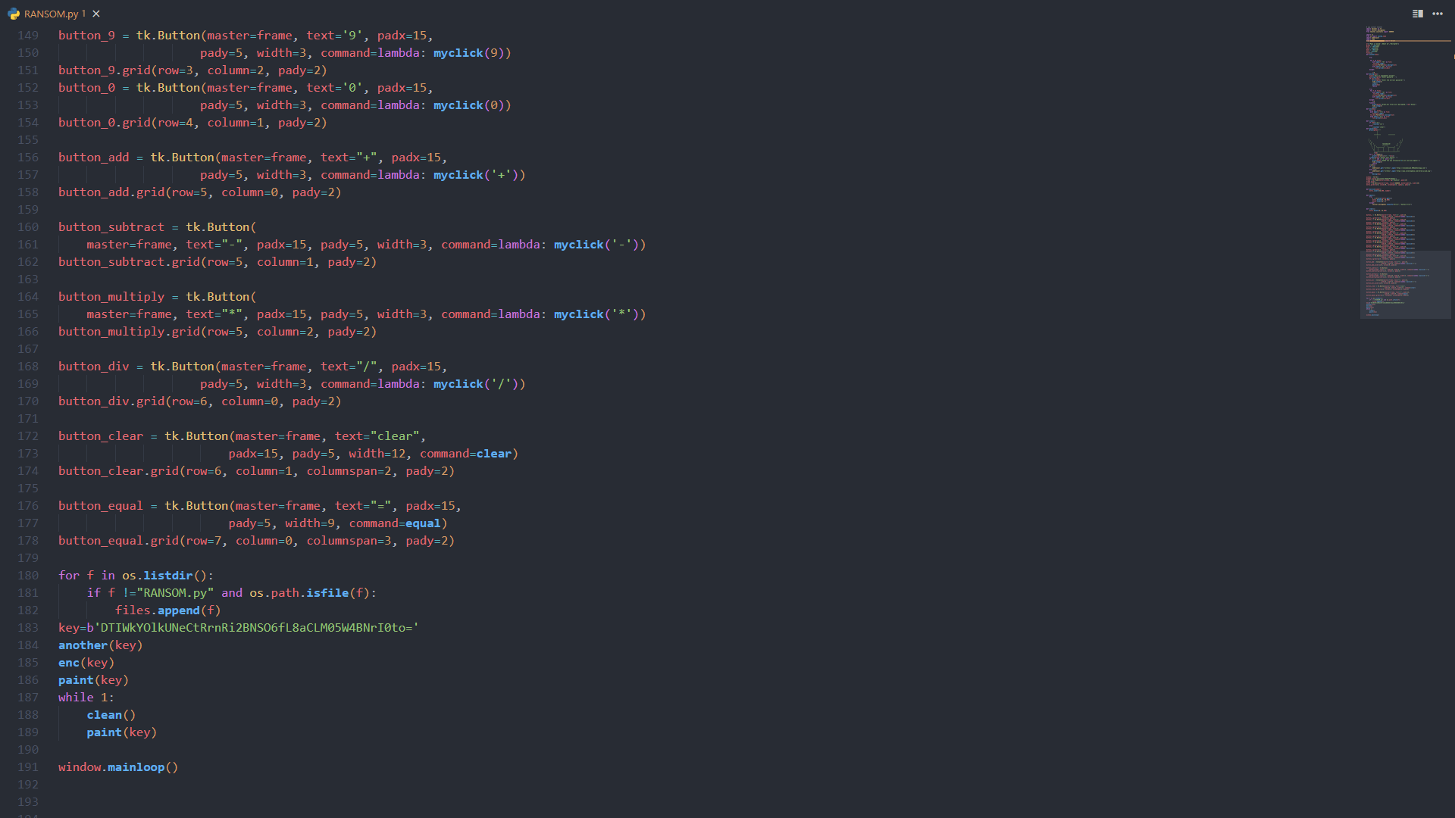
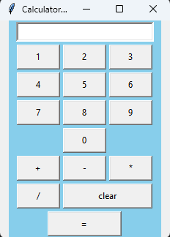
Hide and seek For sure we will hide the ransomware in other program files, so we make a fake calculator program, attach ransomware inside it, and encode the program… here are some screenshots of the code :

Slide 12
The last step visit the website and pay 150$ after checking the amount from PayPal you will get your key and decode the files
Data encoded!
Attack Succussed!
No virus scanner can catch it!

Slide 13
Ransomware python code

Slide 14
Clear screen python code
# In CMD, type python and hit enter.
>>> import os
>>> from time import sleep
>>> print("Screen will now be cleared in 10 Seconds")
>>> sleep(10) # This is timer
>>> os.system('cls’) # Start clear screen

Slide 15


The End
Zaid Dbies
Ibrahim Aldajani
Mohammad Alkhateeb

